Slide 1
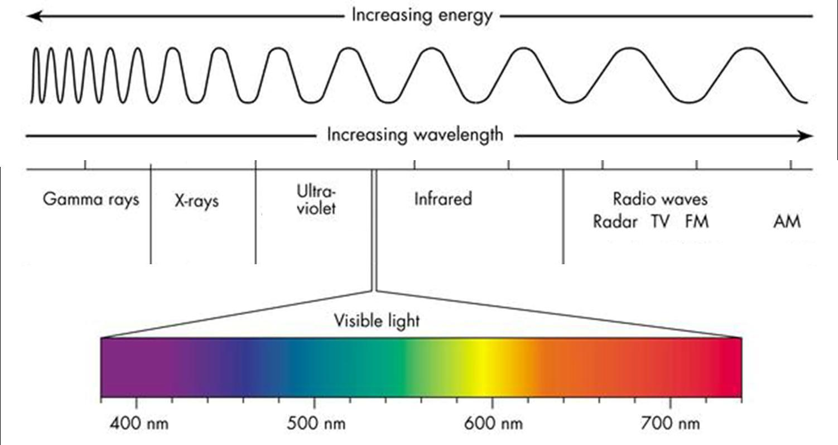
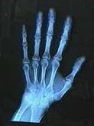
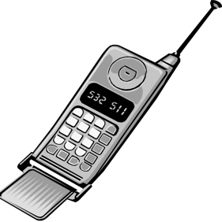
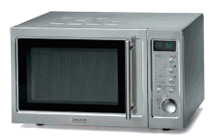
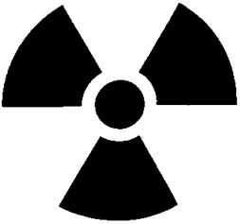
Notes:
The light that we can see with our eyes is actually just a small part of all of the different kinds of light. Even though we cannot see most of this light with our eyes, we can build telescopes to detect all the different kinds of light coming from space. The hotter something is, the more energetic light that comes from it. Each time astronomers started looking at the Universe in a new kind of light, they discovered new objects and saw a whole new view of space.
Extra Info:
- Gamma Rays are the most energetic light and are deadly to humans.
- X-Rays are used by doctors and dentists to take pictures of your bones or teeth to learn about what is going on inside your body that you can’t find out with your eyes.
- Ultraviolet light is the kind of light that gives you a sunburn.
- Visible light is all the colors of the rainbow and the only light that we can see with our eyes.
- Infrared light is detected by night vision goggles that can see the heat from objects even when it is dark out.
- Microwaves are used in microwave ovens to heat up your food.
Radio waves are the least energetic light. They bring us radio, television, and cell phone signals.
All of these different kinds of light are the same ‘stuff’ (electromagnetic radiation). The only difference between them is the amount of energy carried by the light. If you could take energy away from a beam of “deadly” gamma ray light without otherwise disturbing it, it would eventually be visible, then ultimately on into microwave and radio light. This is what happened to the gamma ray light generated by the Big Bang, which is now observable as microwaves.

